Slide 1

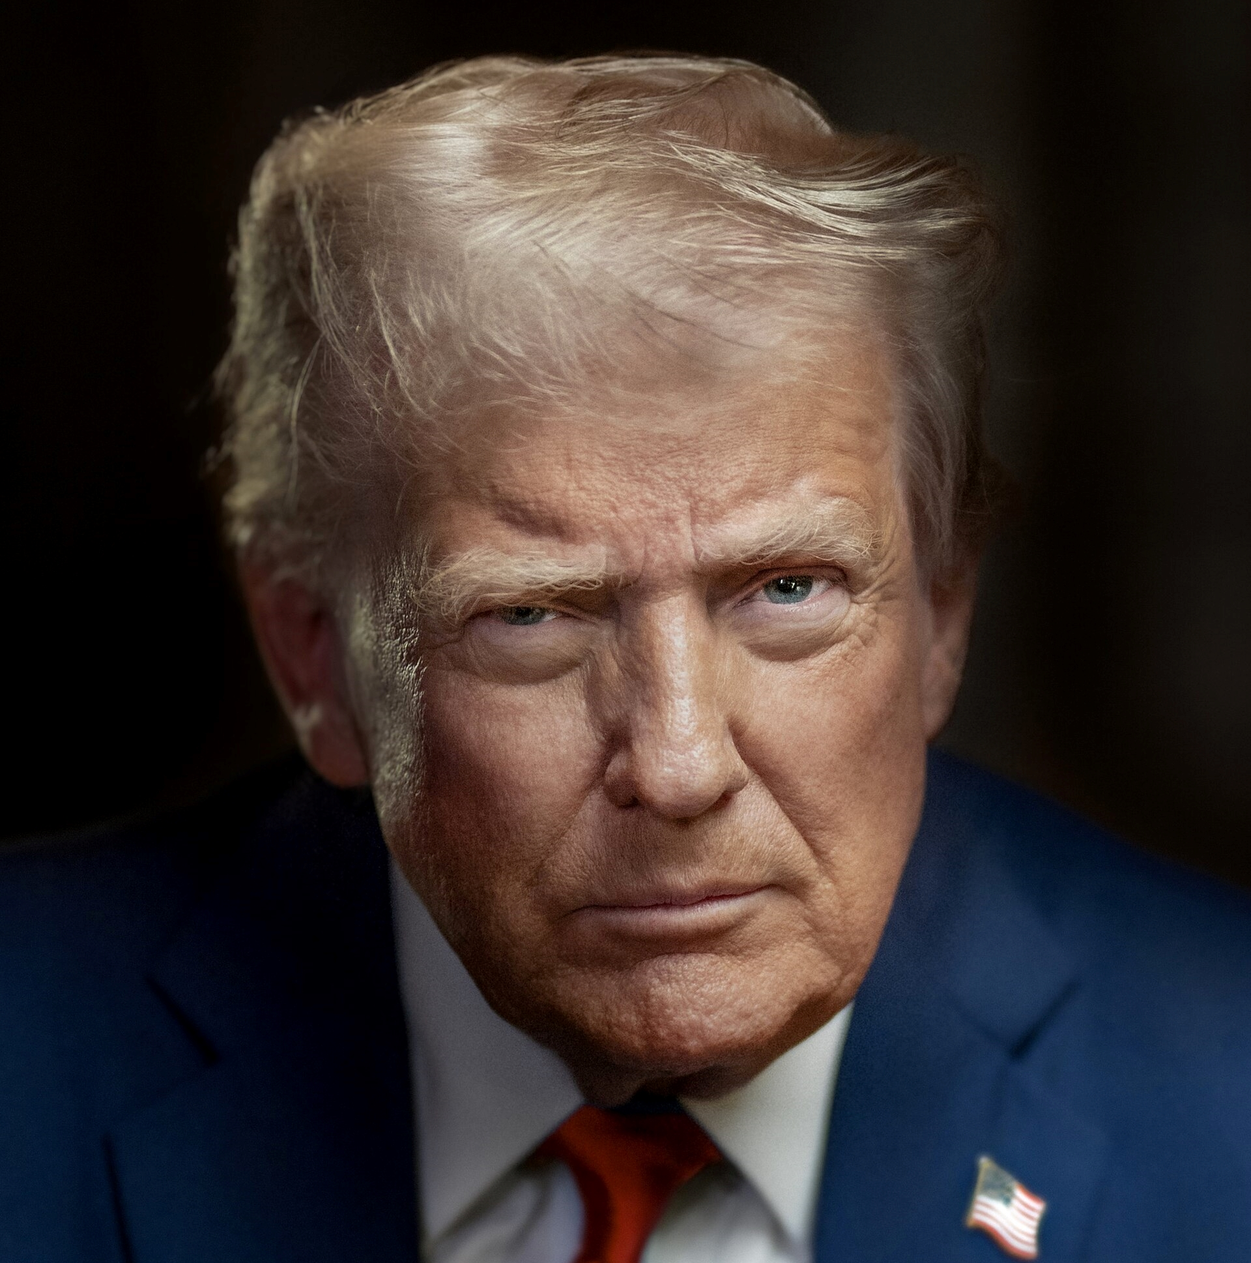
LEARNING MADE EASY
Corruption
dummies
for
Accept bribes with cryptocurrency
Defy courts and ignore laws
Illegally fire staff
Excel at nepotism
Parden felons
Donald Trump
45th & 47th President of the United States

Slide 2
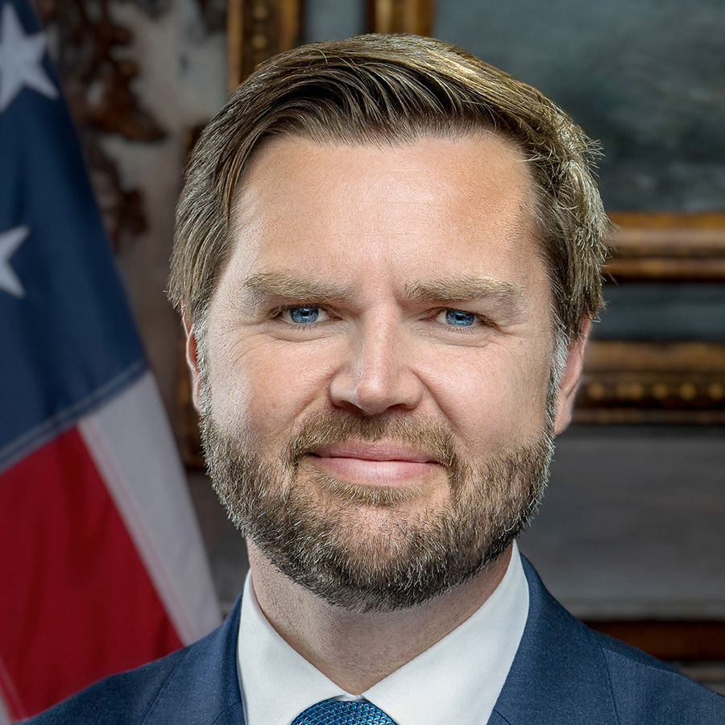
LEARNING MADE EASY
Self-Promotion
dummies
for
Be adept at bragging
Advance your professional & personal goals
Say anything to get attention
Ignore your moral compass
JD Vance
50th Vice President of the United States

Slide 3
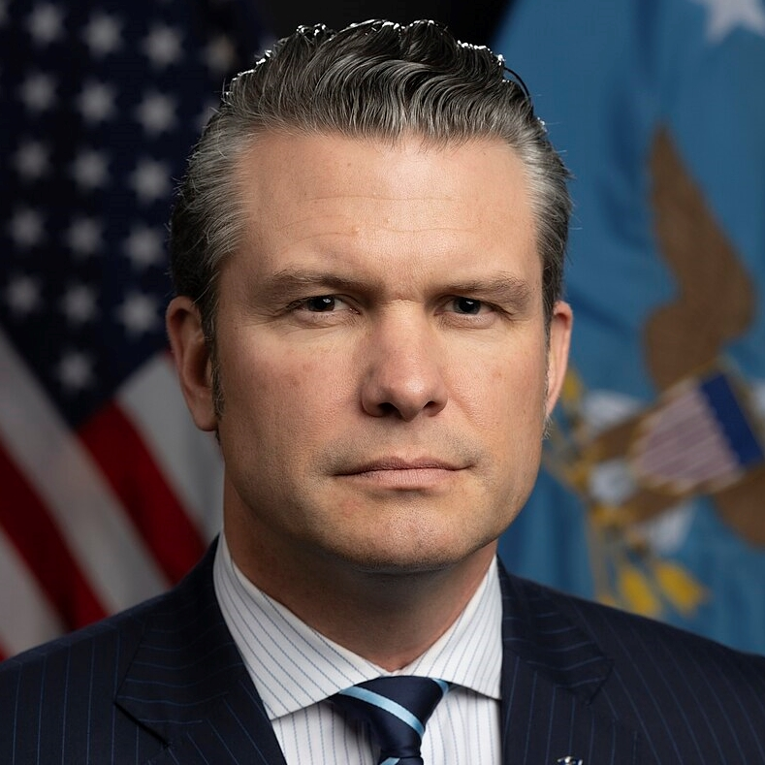
LEARNING MADE EASY
War Crimes
dummies
for
Shoot first, ask questions later
Deploy the military against your citizens
Order the murder of innocents
Oppress the opposition
Pete Hegseth
29th United States Secretary of Defense

Slide 4
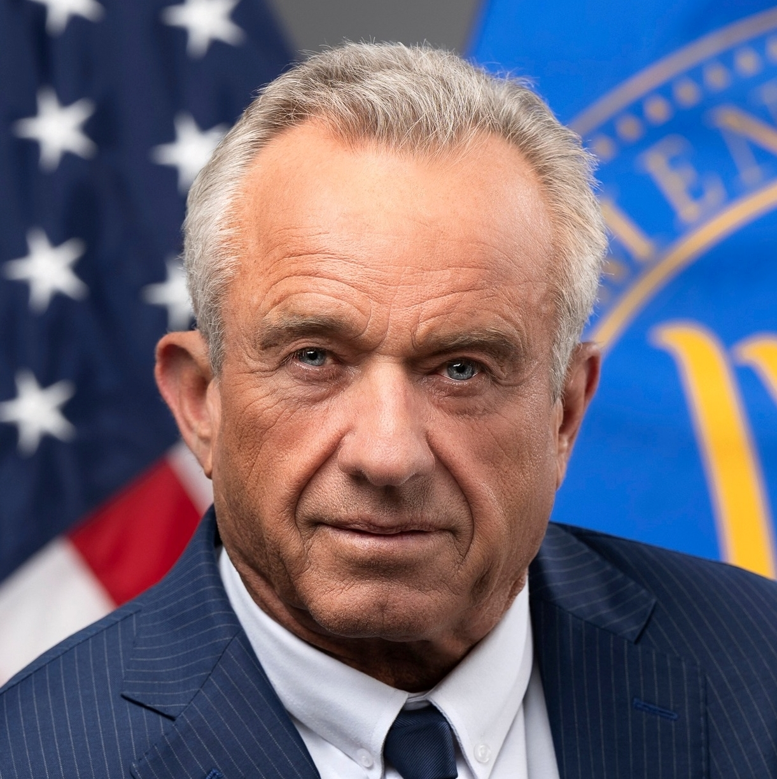
LEARNING MADE EASY
Pseudoscience
dummies
for
Ignore proven science
Promote conspiracy theories
Allow the unvaccinated to
spread disease
Disseminate disinformation
Robert F. Kennedy Jr.
26th United States Secretary of Health and Human Services

Slide 5
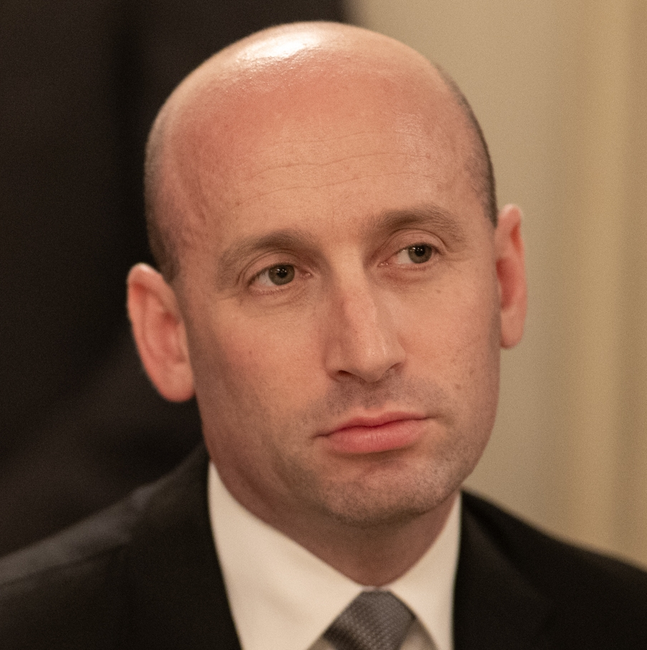
LEARNING MADE EASY
Fascism
dummies
for
Promote white nationalism
Use the military against your own citizens
Imprison & expel people of color
Spawn propaganda
Stephen Miller
White House Deputy Chief of Staff for Policy

Slide 6
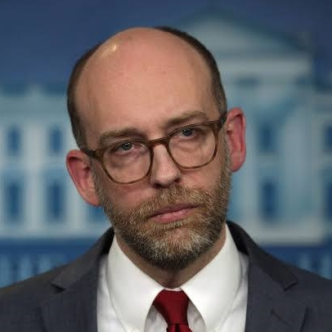
LEARNING MADE EASY
Kleptocracy
dummies
for
Expropriate wealth
Shift assets from the poor to the rich
Enable fraud, waste, & abuse
Promote corporate welfare
Accelerate financial crisis
Russell Vought
Director of Office of Management and Budget

Slide 7
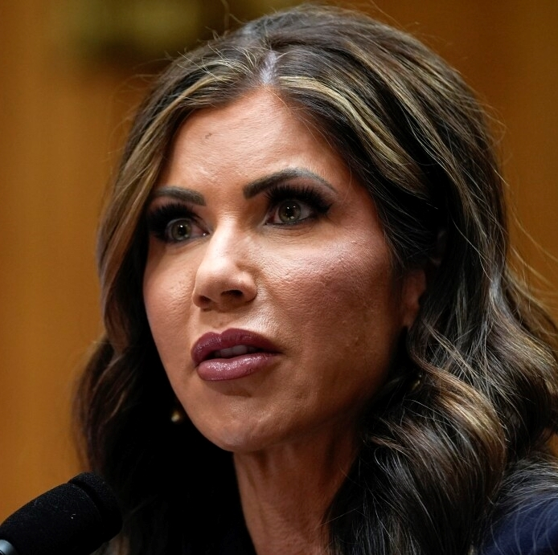
LEARNING MADE EASY
Racism
dummies
for
Fuel hatred
Promote white nationalism
Arrest innocent civilians
Imprison and deport people of color
Bonus: Learn how to kill your dog!
Kristi Noem
8th United States Secretary of Homeland Security

Slide 8
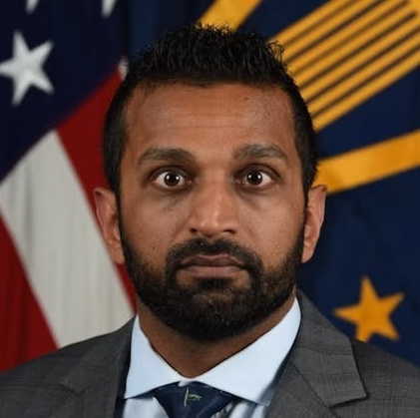
LEARNING MADE EASY
Incompetence
dummies
for
Conceal crimes
Destroy evidence
Allow sex trafficking & pedophilia to go unpunished
Fire competent career staff
Kash Patel
Director of the Federal Bureau of Investigation

Slide 9
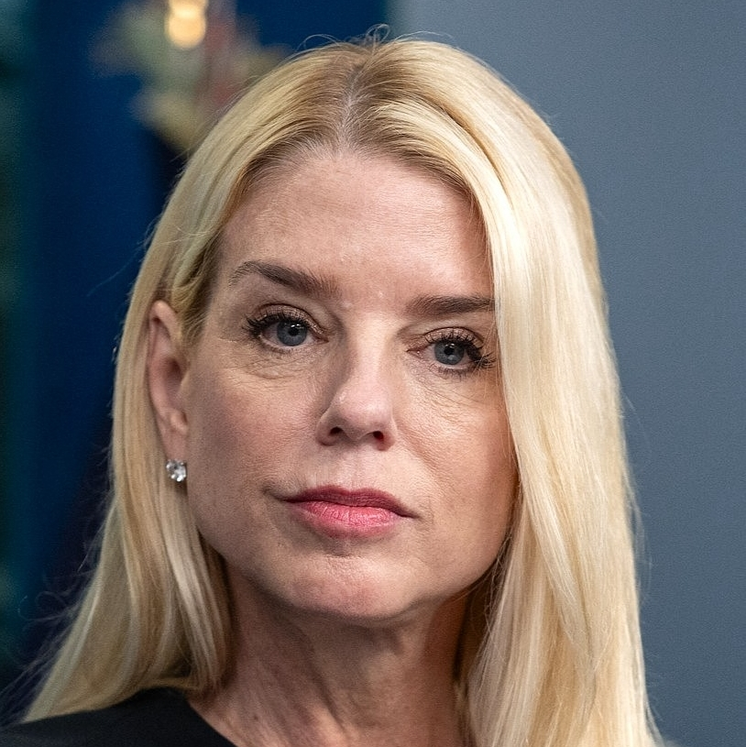
LEARNING MADE EASY
Unethical Behavior
dummies
for
Direct subordinates to prosecute foes
Fire competent & honest staff
Allow crimes to go unpunished
Pam Bondi
87th United States Attorney General

Slide 10
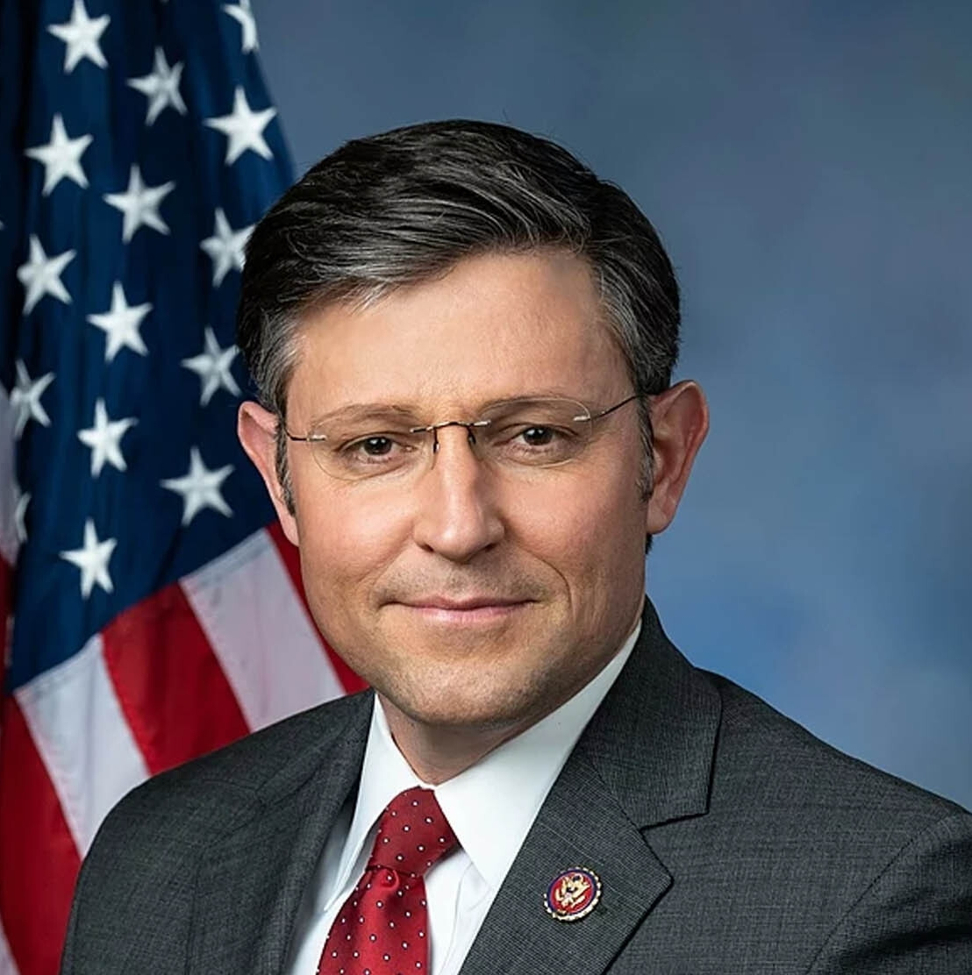
LEARNING MADE EASY
Sycophancy
dummies
for
Excel at flattery
Be a “yes man”
Learn the art of fawning
Never say no
Mike Johnson
Speaker of the US House of Representatives

